Slide 1
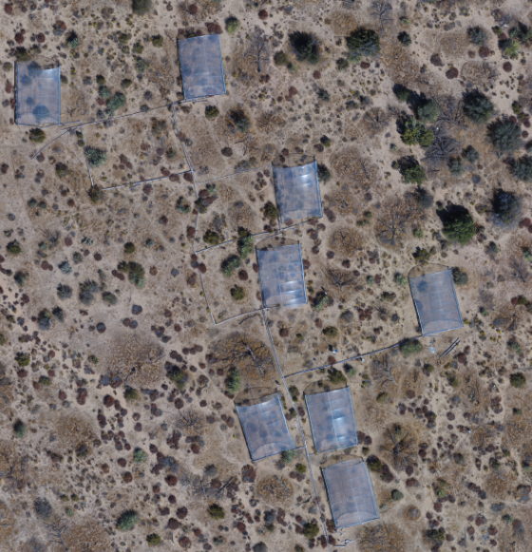
12 Summer Ex
13 Winter Ex
19 Summer 2x
8 control
23 Winter 2x
5 control
14 Winter Ex
7 control
24 Winter 2x
20 Summer 2x
S
10 Summer Ex
M
11 Summer Ex
18 Summer 2x
S
6 control
S
22 Winter 2x
17 Summer 2x
S
D
4 control
3 control
M
S
9 Summer Ex
Red – Summer Exclusion
Double Red – 2X Summer rain
Blue = Winter Exclusion
Double Blue = 2x Winter rain
Yellow = Control
S = Sensor (temp, RH, NDVI
M = multiplexor
D = Datalogger, solar power
21 Winter 2x
15 Winter Ex
M
S
16 Winter Ex
1 control
2 control

